Slide 1
Chapter 1: Introduction to Systems Analysis and Design

Slide 2
Learning Objectives
Team roles & skill sets
Object-oriented systems characteristics
Object-oriented systems analysis & design
The Unified Process & its extensions
The Unified Modeling Language (UML)

Slide 3
Project Roles
Business Analyst
Systems Analyst
Infrastructure Analyst
Project Manager
Data Architect
Software engineer

Slide 4
Object-Oriented Systems Analysis & Design
Attempts to balance data and process
Utilizes the Unified Modeling Language (UML) and the Unified Process
Characteristics of OOAD:
Use-case Driven
Architecture Centric
Iterative and Incremental

Slide 5
Characteristics of Object-Oriented Systems
Classes & Objects
Object (instance): instantiation of a class
Attributes: information that describes the class
State: describes its values and relationships at a point in time
Methods & Messages
Methods: the behavior of a class
Messages: information sent to an object to trigger a method (procedure call)

Slide 6
Characteristics of Object-Oriented Systems (cont.)
Encapsulation & information hiding
Encapsulation: combination of process & data
Information hiding: functionality is hidden
Inheritance
General classes are created (super classes)
Subclasses can inherit data and methods from a superclass

Slide 7
Characteristics of Object-Oriented Systems (cont.)
Polymorphism & dynamic binding
Polymorphism: the same message can have different meanings
Dynamic binding: type of object is not determined until run-time

Slide 8
Object-Oriented Systems Analysis & Design
Use-case driven
Use-cases define the behavior of a system
Each use-case focuses on one business process
Architecture centric
Functional (external) view: focuses on the user’s perspective
Static (structural) view: focuses on attributes, methods, classes & relationships
Dynamic (behavioral) view: focuses on messages between classes and resulting behaviors

Slide 9
Object-Oriented Systems Analysis & Design (cont.)
Iterative & incremental
Undergoes continuous testing & refinement
The analyst understands the system better over time

Slide 10
The Unified Process
A specific methodology that maps out when and how to use the various UML techniques for object-oriented analysis and design
A two-dimensional process consisting of phases and workflows
Phases are time periods in development
Workflows are the tasks that occur in each phase
Activities in both phases & workflows will overlap

Slide 11
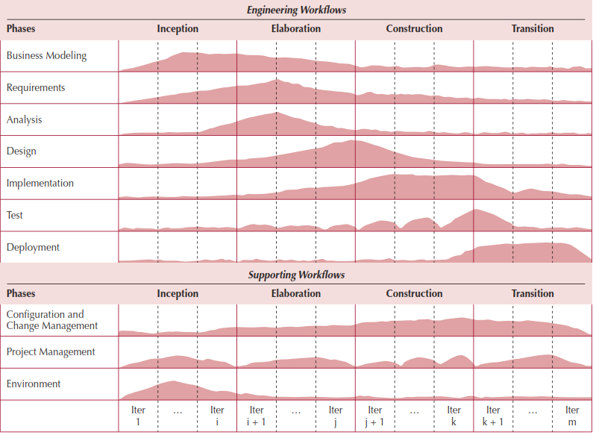
The Unified Process

Slide 12
Unified Process Phases
Inception
Feasibility analyses performed
Workflows vary but focus is on business modeling & requirements gathering
Elaboration
Heavy focus on analysis & design
Other workflows may be included
Construction: Focus on programming (implementation)
Transition--Focus on testing & deployment

Slide 13
Unified Modeling Language
Provides a common vocabulary of object-oriented terms and diagramming techniques rich enough to model any systems development project from analysis through implementation
Version 2.5 has 15 diagrams in 2 major groups:
Structure diagrams
Behavior diagrams

Slide 14
UML Structure Diagrams
Represent the data and static relationships in an information system
Class
Object
Package
Deployment
Component
Composite structure

Slide 15
UML Behavior Diagrams
Depict the dynamic relationships among the instances or objects that represent the business information system
Activity
Sequence
Communication
Interaction overview
Timing
Behavior state machine
Protocol state machine,
Use-case diagrams

Slide 16
Summary
Object-Oriented Systems Analysis and Design (OOSAD) uses a use-case-driven, architecture-centric, iterative, and incremental information systems development approach
The Unified Process is a two-dimensional systems development process described with a set of phases and workflows
The Unified Modeling Language, or UML, is a standard set of diagramming techniques

